Slide 1
How to design
and execute sales business processes

Slide 2






About BPMonline
BPMonline is a global provider of first-class Customer Relationship Management (CRM) and Business Process Management (BPM) solutions. Powerful and user-friendly, BPMonline CRM solution brings easy and affordable process management tools to CRM and sales professionals.
BPMonline is the winner of a number of prestigious CRM industry awards, including: 2013 Top 15 CRM Software Awards by ISM, CRM Watchlist, European IT & Software Excellence Awards 2013, CRM Excellence Award by TMC, Customer Service Rising Star and CRM Idol 2011.
COMPANY
EXPERIENCE
PLATFORM
  400 employees
  250 partners
  35 countries
  10 years
  5 000 customers
  350 000 end users
  Open Configuration
  BPM+CRM
  Dedicated Customer Success Approach

Slide 3




2 Strategies to Ensure Sales Volumes
People
Processes
Sales
Strategies
Hire and train Gifted Professionals
Implement and monitor effective sales processes
Condition
Specialists are to meet following requirements:
High self-organization, focus on earning profits
Condition
Standards and procedures – teach and monitor
Assign responsibilities according to process, measure KPI’s.
Use KPI to determine remuneration
Educate sales techniques
Leaving Company and taking clients
Stability periods from 7 to 15 months
Оperating expenses
Long-term outlook

Slide 4

Symptoms to watch for
What are the symptoms to watch for, and when should company start thinking of implementing process-based approach to sales?
Sales performance gap
Hero-oriented sales culture
Lack of communication between sales & other departments
Loss of time (wasted on executing non-customer related activities)
Sales forecasting is difficult
Unable to continually introduce changes

Slide 5
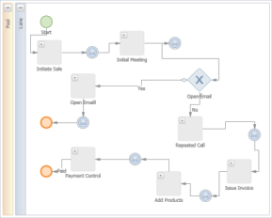
Purposes
MEASURABLE ACTIONS
Forecast
Outcome
Black Box
Process-based management allows you to look inside the ‘black box’ and
provide sales reps with a regulated sequence of actions, telling them what to do and enables you to connect components of the sales process

Slide 6
Purposes
Implementation of process-based approach aims
at boosting sales and achieving the following:
Identify and liberate sales bottlenecks – Constantly test different approaches to see what works best, exposing bottlenecks and inefficiencies that delay revenues.
Boost sales productivity – With BPM you can automate time-consuming tasks
Team-up with other departments – BPM lets you design and introduce processes that bring these departments into the loop at just the right time. As an example, finance should ping sales whenever a customer nears the end of its sales contract.
Pursue continual improvement – ensure change management and continually introduce and automate new processes.
Enhance overall sales management – "the devil is in the detail" – measure your actions before you start analyzing results.

Slide 7
Role of sales process in sales management structure
Sales Strategy
Sales Targets
Organizational Structure
Channel Strategy
Sales business processes
Sales Tactics
Tactical plans and sales quotes
The structure of sales functions - roles, responsibilities
Sales analysis and operational control
Sales methodology
Sales
Operations
Sales regulations
Operational KPI
Workday Planning
Sales trainings
Requirements for sales staff
Sales plans and quotes by positions
Notes:
7

Slide 8

Structure of Sales Process
Process Diagram
Regulations
Responsibility Assigned Matrix
KPI

Slide 9

Process Diagram Components
Events – denotes something that happens
Actions – describes the kind of work which must be done
Gateways – determines forking and merging of paths, depending
on the conditions expressed
Connections – sequences, messages, and associations
Roles – separated participants/functions
Artifacts – bring some more information into the model/diagram

Slide 10
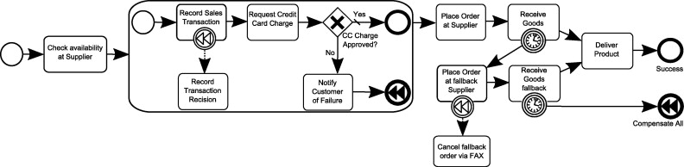
BPMN 2.0
We recommend using BPMN 2.0 standard, which
is simple and clear for both business managers and technical specialists.

Slide 11

Sales process content
‘Super-Salesperson’ – Evaluate a pattern of processes that let sales people consistently hit targets.
Experience – Sales assumptions based on company experience
Voice of the Customer – customer feedbacks that help to get a detailed information about customer’s needs and requirements.
Customer Experience-based modeling –specialists propose their vision of which activities (steps of the process) are to be eliminated, improved or taken as a standard.
Processes with multiple outcomes
Notes:
Нужно графически оформить: выделить булеты и отдельно пояснения к ним

Slide 12
Business process regulations
Steps | Description | Incoming data | Outgoing data | Responsible | Deadline
Describes principles for choosing process steps | When entering the process and each time after completing each of the following steps, CRM-system asks the user what the next step of the process. Possible variants: The need for a meeting; The need for a call; Need to send materials / documents; Need to create price proposal; Preliminary documents are to be signed; Readiness to apply; The client agrees with the decision of the credit committee; Deferred interest; Refusal. | Creation of a sales card where customer's interest is indicated. | Following step according to set process | Responsible manager indicated in the sales card | Describes deadlines and terms for each step of the process

Slide 13
Setting KPIs
KPI | Description | Organizational structures | Customer segments
Negotiation performance for a set period: willingness to apply (%) refusal (%) | The number of processes that culminated in readiness to submit application, divided by the total number of negotiations (processes) that were completed for the period; The number of processes that culminated in refusal to apply, divided by the total number of negotiations (processes) that were completed in the period | Corporate Sales / Regional Units/ Departments / Staff | industry / importance

Slide 14
Change Management
%
/
80
20
AS-IS
%
TO-BE

Slide 15
Change Management
Techniques for process mapping and design:
‘bottom-up’ – this approach means that the necessary changes are not to be imposed
by top management, but should be initiated by small or subordinate units and progress
to a larger one
Permanent learning – every single change or introduction of a new process should be accompanied by educational initiatives inside the company (trainings, seminars, workshops etc.)
Process artifacts – all changes are to be available to anyone anytime. In order
to achieve this company should create so-called ‘process artifacts’ (like infographics, webinars etc.)
Sharing expertise – effective change management and process mapping requires
a high level of internal communications which allows sharing relevant success stories and best practices on a regular basis.

Slide 16

Change Management
The overall goal is to implement process-based approach
in the way of thinking.

Slide 17
Execution: Automate It!
Impossible to implement processes without automation
Automation ensures process manageability
Regular sales meetings
Reports and monitoring
Review every 15/30/60/90 days
Gamification elements etc.

Slide 18

How to simplify work processes with BPM automation?
Easy Consumer UI
Context Interface
Possibility to easily add new actions
Elements for brainstorming and decisioning
Gamification tools

Slide 19
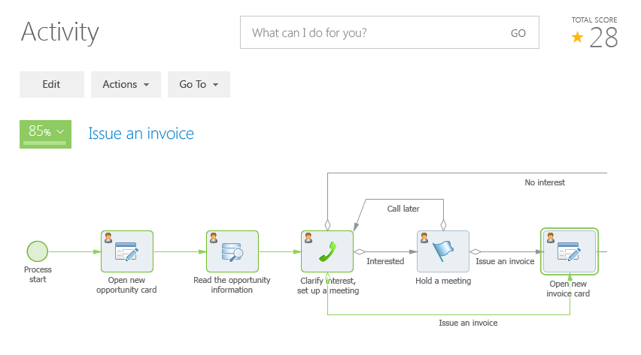
Business Process Management

Slide 20


Conclusion: business outcomes
Clear picture of actions
and real performance
Possibility to analyze and improve every single step
in sales processes
Boost sales productivity
Increase number of win rates
Ability to drive changes
on the fly

